Slide 1

https://goo.gl/jPZyfk

Slide 2
What is
?
A library for managing states with reducers
The better way of communication between components
First step towards functional programming
A briant piece of work by Dan Abramov (and many others)
https://goo.gl/jPZyfk

Slide 3
What’s a reducer ?
A simple function that take state
and an action,
And returns a new state
https://goo.gl/jPZyfk

Slide 4
Redux reducers handle state transitions, but they must be
handled synchronously
https://goo.gl/jPZyfk

Slide 5
But what about async?
User interactions
AJAX
Web socket
Animations
https://goo.gl/jPZyfk

Slide 6
…and, harder to manage…
Composing multiple async sources
AJAX Cancellation
Composed AJAX
Debounced form submission
Drag & drop
Advanced Web socket use
https://goo.gl/jPZyfk

Slide 7
A high-level look at asynchrony in Redux
Async
1. Dispatch
action
2. Call API
3. Get Response
Components
Redux
store
API
4. Store Data
4. Store Error
5. Render
https://goo.gl/jPZyfk

Slide 8
Redux manage asynchrony with middlewares
Most redux middlewares use callBacks or promises
https://goo.gl/jPZyfk

Slide 9
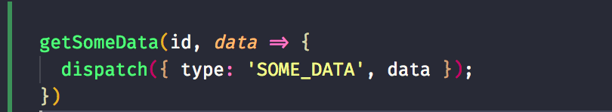
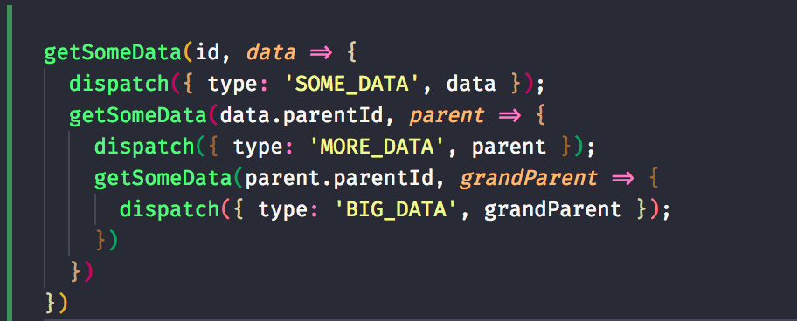
Callbacks
https://goo.gl/jPZyfk

Slide 10
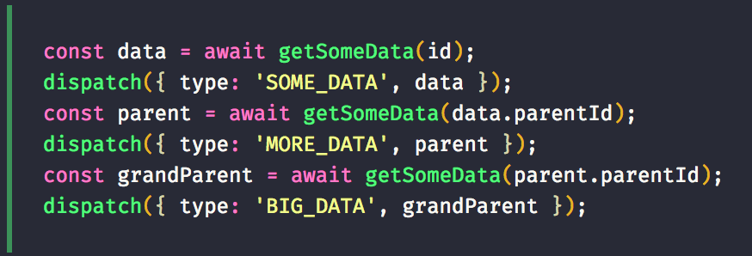
With promises (cleaner)
https://goo.gl/jPZyfk

Slide 11
Promises
Guarenteed future
Immutable
Single value
Catching
https://goo.gl/jPZyfk

Slide 12
Promises
Guarenteed future
Immutable
Single value
Catching
https://goo.gl/jPZyfk

Slide 13
Promises
Guarenteed future
Immutable
Single value
Catching
Auto-complete
Changes before data finishes loading
https://goo.gl/jPZyfk

Slide 14
Observables
A set of events
Any number of values
Over any amount of time
Cancellable
Lazy
https://goo.gl/jPZyfk

Slide 15
RxJS
Observables and functions to create and compose Observables
“Lodash for async”
https://goo.gl/jPZyfk

Slide 16

RxJS
https://goo.gl/jPZyfk

Slide 17
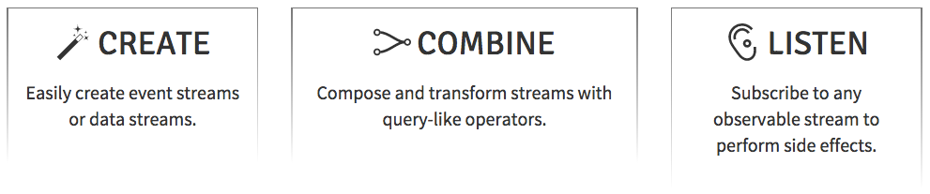
RxJS
https://goo.gl/jPZyfk

Slide 18
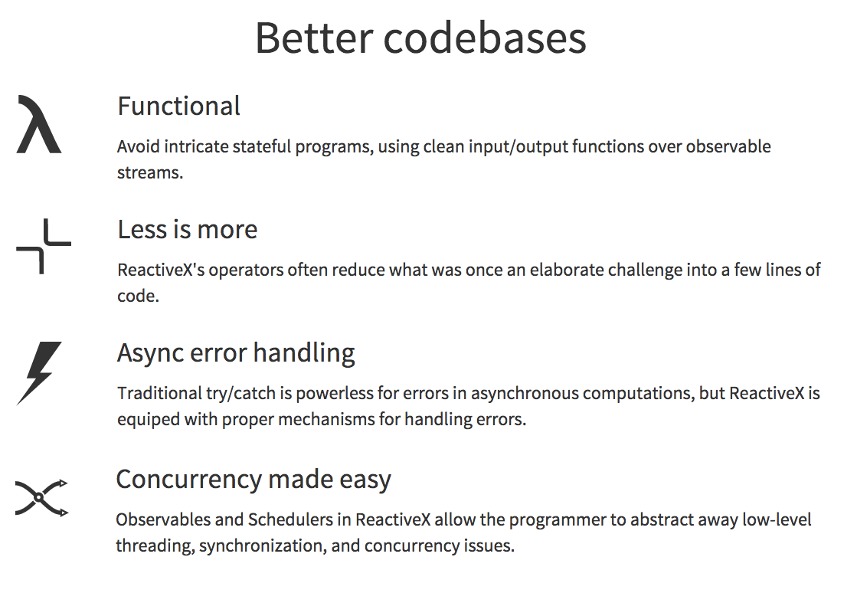
RxJS
https://goo.gl/jPZyfk

Slide 19
Observables
Observable
Flip
X
Subscriber
https://goo.gl/jPZyfk

Slide 20
Create Observables
of('hello')
from([1, 2, 3, 4])
interval(1000)
ajax('http://example.com')
webSocket('ws://echo.websocket.com')
fromEvent(button, ‘click')
many more...
https://goo.gl/jPZyfk

Slide 21
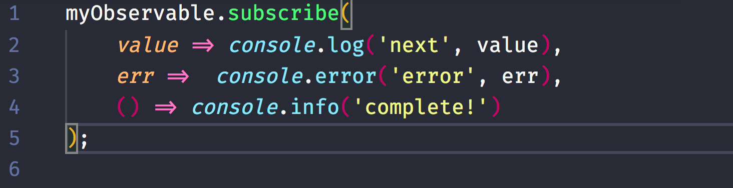
Subscribe an Observable
https://goo.gl/jPZyfk

Slide 22
+
=
https://goo.gl/jPZyfk

Slide 23
EPICS
INPUT: Action over time in an Observable
OUTPUT: Downstream actions in an Observable
A function that takes a stream of all actions dispatched
and returns a stream of new actions to dispatch
Jay Phelp, Netflix

Slide 24
DEMO
Use EPICs in Redux
https://goo.gl/jPZyfk

Slide 25
Pros/Cons
+
-
Make it easy to compose and control complex async tasks with RxJS and Redux
Can use Redux tooling
You don’t end up managing your own Rx subscriptions
If used with react-redux, makes all of your components stateless
Need to know redux in advance
Should learn RxJS in advance
RxJs has a bit of a learning curve
https://goo.gl/jPZyfk

Slide 26
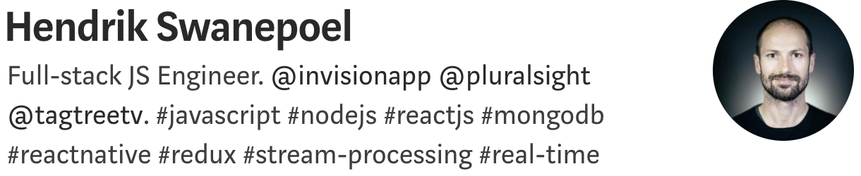
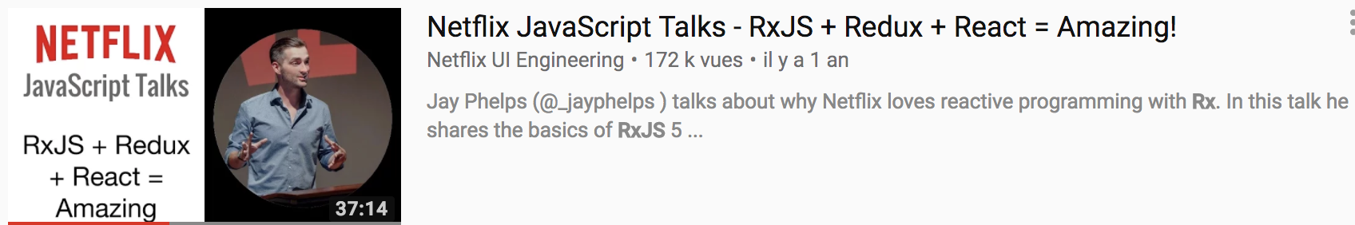
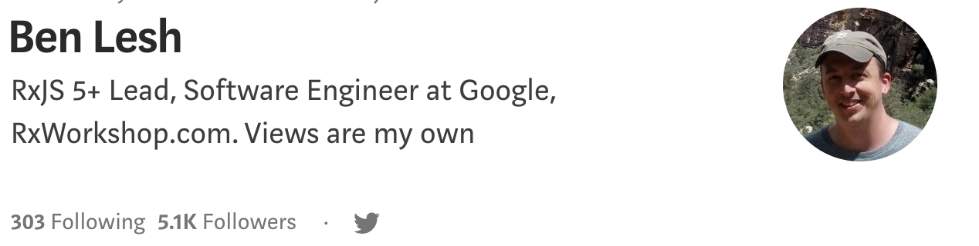
https://goo.gl/jPZyfk

Slide 27

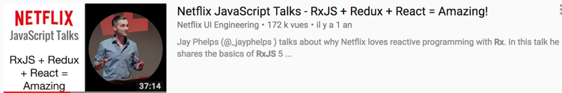

Thank you !
https://goo.gl/jPZyfk

